Slide 1

Kyiv Place Store
The information website for tourists from pupils school "Summer Java"

Slide 2
Meanig of this project?

Slide 3
What did we worked in project with?

Slide 4
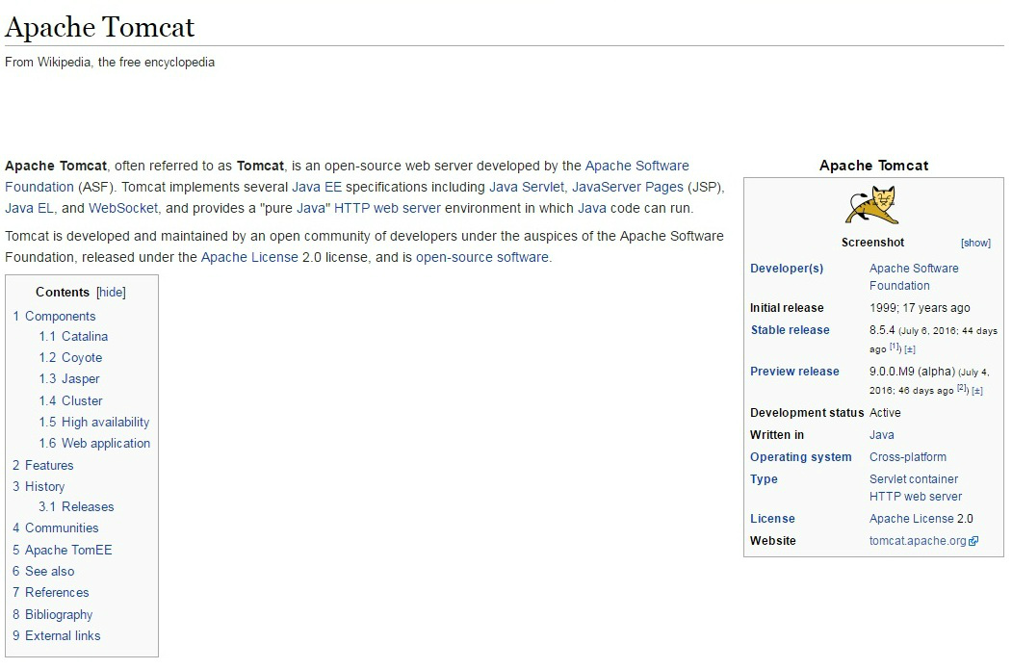
Which special sourses did we include?

Slide 5
Thank you for attention

